Slide 1
One hidden layer
Neural Network
Neural Networks
Overview

Slide 2







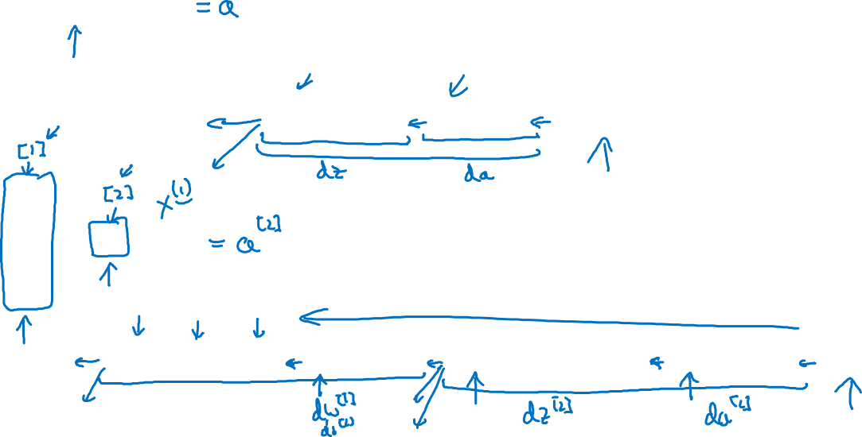





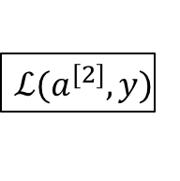







What is a Neural Network?
$$x_{1}$$
$$x_{2}$$
$$\hat{y}$$
$$x_{3}$$
x
w
$$z=w^{T}x+b$$
$$a=σ(z)$$
$$ℒ(a,y)$$
b
$$x_{1}$$
$$x_{2}$$
$$\hat{y}$$
$$x_{3}$$
x
$$W^{[1]}$$
$$z^{[1]}=W^{[1]}x+b^{[1]}$$
$$a^{[1]}=σ(z^{[1]})$$
$$z^{[2]}=W^{[2]}a_{ }^{[1]}+b^{[2]}$$
$$a^{[2]}=σ(z^{[2]})$$
$$ℒ(a^{[2]},y)$$
$$b^{[1]}$$
$$W^{[2]}$$
$$b^{[2]}$$

Slide 3
One hidden layer
Neural Network
Neural Network
Representation

Slide 4


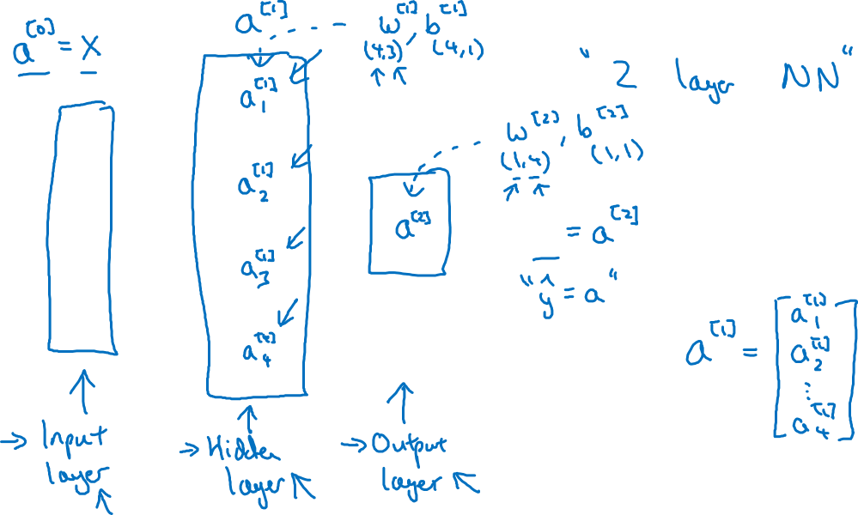


Neural Network Representation
$$x_{1}$$
$$x_{2}$$
$$\hat{y}$$
$$x_{3}$$

Slide 5
One hidden layer
Neural Network
Computing a
Neural Network’s
Output

Slide 6











Neural Network Representation
$$x_{1}$$
$$x_{1}$$
$$x_{2}$$
$$σ(z)$$
$$a=\hat{y}$$
$$x_{2}$$
$$\hat{y}$$
$$w^{T}x+b$$
$$z$$
$$a$$
$$x_{3}$$
$$x_{3}$$
$$z=w^{T}x+b$$
$$a=σ(z)$$

Slide 7

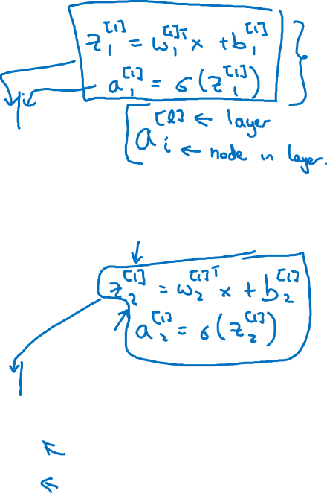





Neural Network Representation
$$x_{1}$$
$$x_{1}$$
$$x_{2}$$
$$σ(z)$$
$$a=\hat{y}$$
$$x_{2}$$
$$\hat{y}$$
$$w^{T}x+b$$
$$z$$
$$a$$
$$x_{3}$$
$$x_{3}$$
$$z=w^{T}x+b$$
$$x_{1}$$
$$a=σ(z)$$
$$x_{2}$$
$$\hat{y}$$
$$x_{3}$$

Slide 8

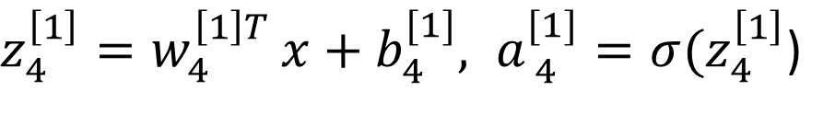


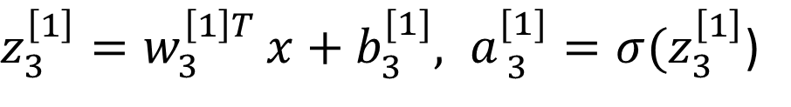


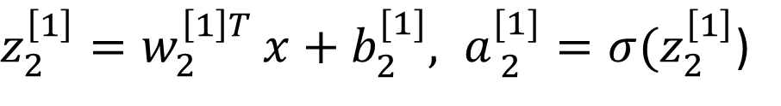

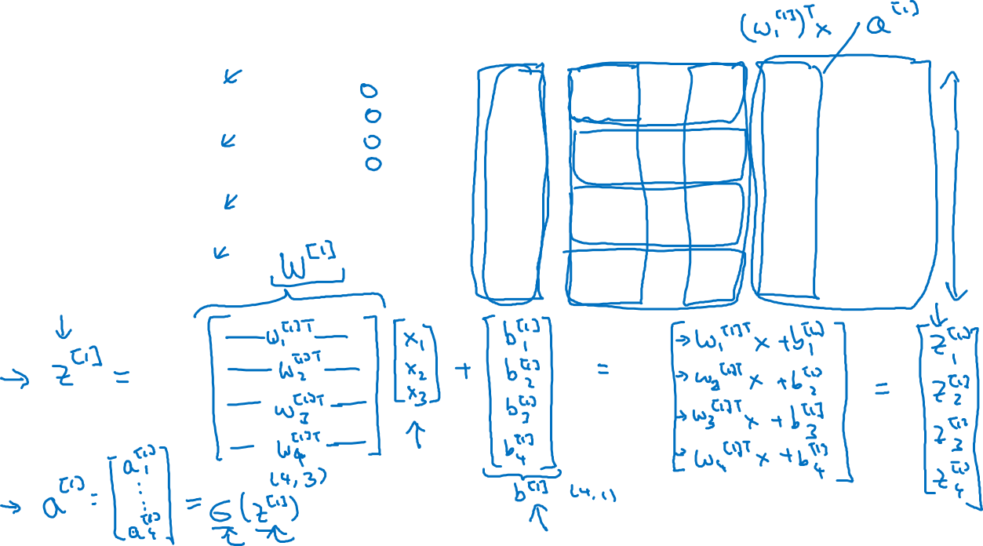
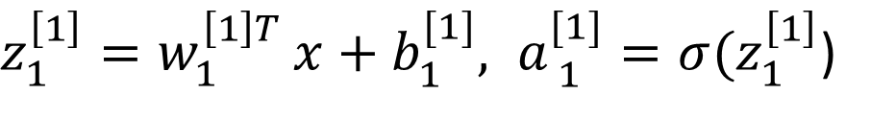


Neural Network Representation
$$a_{1}^{\left[1\right]}$$
$z_{1}^{\left[1\right]}=w_{1}^{{\left[1\right]T}^{ }}x+b_{1}^{[1]}, a_{ 1}^{[1]}=σ(z_{1}^{\left[1\right]}$)
$$x_{1}$$
$$a_{2}^{\left[1\right]}$$
$z_{2}^{\left[1\right]}=w_{2}^{{\left[1\right]T}^{ }}x+b_{2}^{[1]}, a_{ 2}^{[1]}=σ(z_{2}^{\left[1\right]}$)
$$x_{2}$$
$$\hat{y}$$
$$a_{3}^{\left[1\right]}$$
$z_{3}^{\left[1\right]}=w_{3}^{{\left[1\right]T}^{ }}x+b_{3}^{[1]}, a_{ 3}^{[1]}=σ(z_{3}^{\left[1\right]}$)
$$x_{3}$$
$$a_{4}^{\left[1\right]}$$
$z_{4}^{\left[1\right]}=w_{4}^{{\left[1\right]T}^{ }}x+b_{4}^{[1]}, a_{ 4}^{[1]}=σ(z_{4}^{\left[1\right]}$)

Slide 9



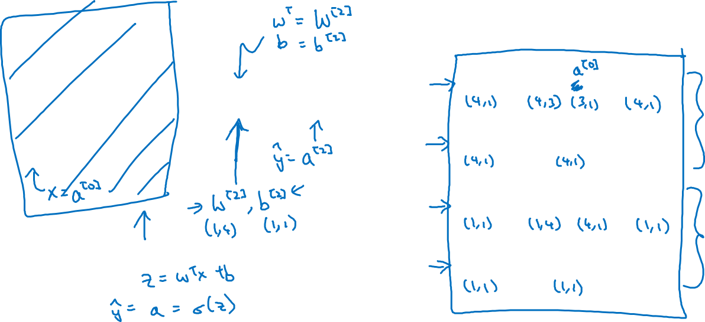

Neural Network Representation learning
$$a_{1}^{\left[1\right]}$$
Given input x:
$$x_{1}$$
$$a_{2}^{\left[1\right]}$$
$$z^{\left[1\right]}=W^{\left[1\right]}x+b^{\left[1\right]}$$
$$x_{2}$$
$$\hat{y}$$
$$a_{3}^{\left[1\right]}$$
$$x_{3}$$
$$a^{\left[1\right]}=σ(z^{\left[1\right]})$$
$$a_{4}^{\left[1\right]}$$
$$z^{\left[2\right]}=W^{\left[2\right]}a^{\left[1\right]}+b^{\left[2\right]}$$
$$a^{\left[2\right]}=σ(z^{\left[2\right]})$$

Slide 10
One hidden layer
Neural Network
Vectorizing across
multiple examples

Slide 11




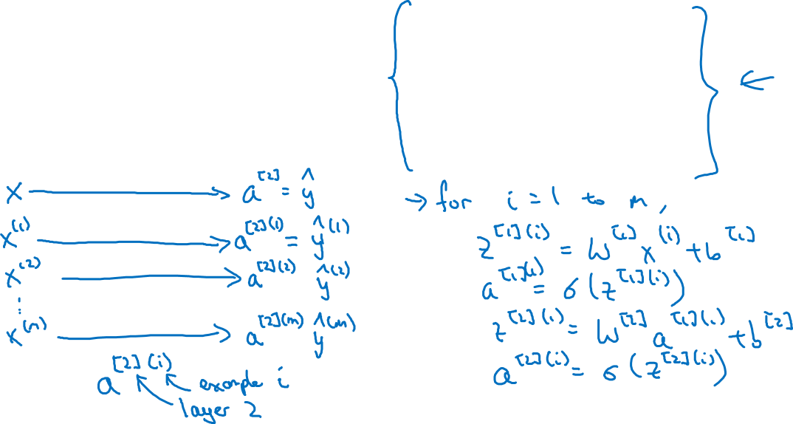

Vectorizing across multiple examples
$$z^{\left[1\right]}=W^{\left[1\right]}x+b^{\left[1\right]}$$
$$x_{1}$$
$$a^{\left[1\right]}=σ(z^{\left[1\right]})$$
$$x_{2}$$
$$\hat{y}$$
$$z^{\left[2\right]}=W^{\left[2\right]}a^{\left[1\right]}+b^{\left[2\right]}$$
$$x_{3}$$
$$a^{\left[2\right]}=σ(z^{\left[2\right]})$$

Slide 12
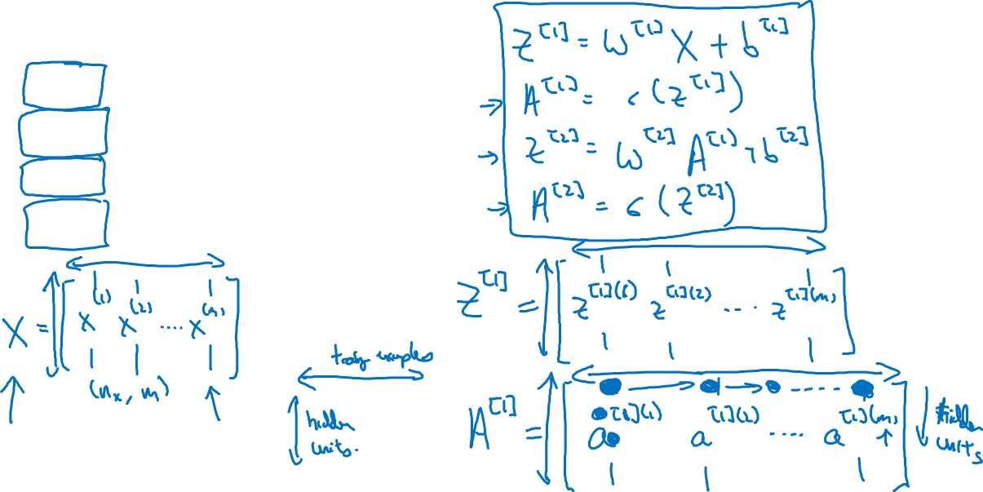




Vectorizing across multiple examples
for i = 1 to m:
$$z^{\left[1\right](i)}=W^{\left[1\right]}x^{(i)}+b^{\left[1\right]}$$
$$a^{\left[1\right](i)}=σ(z^{\left[1\right]\left(i\right)})$$
$$z^{\left[2\right](i)}=W^{\left[2\right]}a^{\left[1\right](i)}+b^{\left[2\right]}$$
$$a^{\left[2\right](i)}=σ(z^{\left[2\right]\left(i\right)})$$

Slide 13
One hidden layer
Neural Network
Explanation
for vectorized
implementation

Slide 14
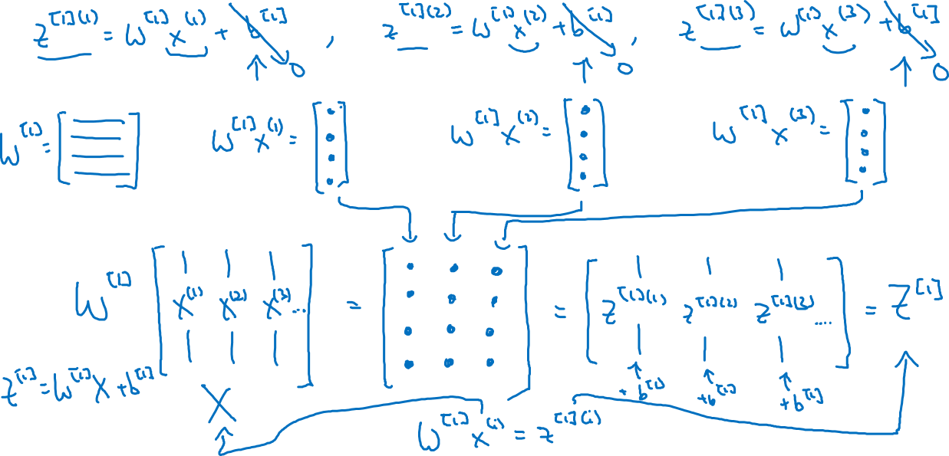
Justification for vectorized implementation

Slide 15











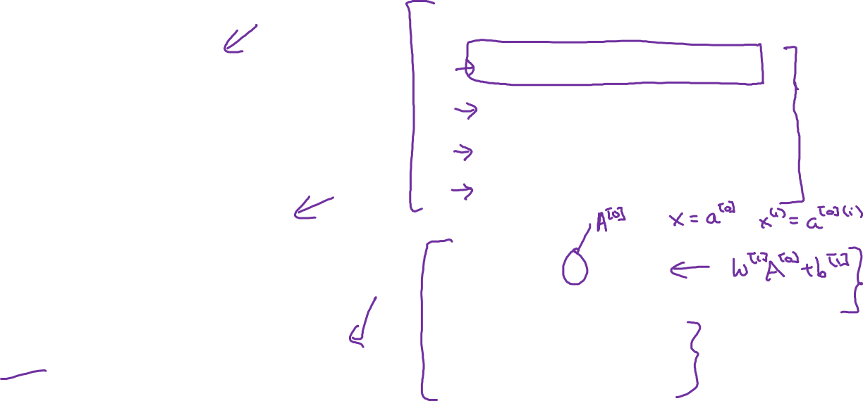





Recap of vectorizing across multiple examples
for i = 1 to m
$$x_{1}$$
$$z^{\left[1\right](i)}=W^{\left[1\right]}x^{(i)}+b^{\left[1\right]}$$
$$x_{2}$$
$$\hat{y}$$
$$x_{3}$$
$$a^{\left[1\right](i)}=σ(z^{\left[1\right]\left(i\right)})$$
$$z^{\left[2\right](i)}=W^{\left[2\right]}a^{\left[1\right](i)}+b^{\left[2\right]}$$
$$a^{\left[2\right](i)}=σ(z^{\left[2\right]\left(i\right)})$$
$$X=$$
$$x^{(1)}$$
$$x^{(2)}$$
…
$$x^{(m)}$$
$$Z^{\left[1\right]}=W^{\left[1\right]}X+b^{\left[1\right]}$$
$$A^{\left[1\right]}=σ(Z^{\left[1\right]})$$
$$Z^{\left[2\right]}=W^{\left[2\right]}A^{\left[1\right]}+b^{\left[2\right]}$$
$A^{[1]}=$
$$a^{[1](1)}$$
$$a^{[1](2)}$$
$$a^{[1](m)}$$
…
$$A^{\left[2\right]}=σ(Z^{\left[2\right]})$$

Slide 16
One hidden layer
Neural Network
Activation functions

Slide 17




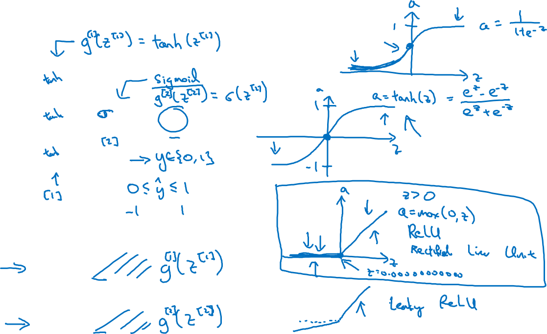


Activation functions
$$x_{1}$$
$$x_{2}$$
$$\hat{y}$$
$$x_{3}$$
Given x:
$$z^{\left[1\right]}=W^{\left[1\right]}x+b^{\left[1\right]}$$
$$a^{\left[1\right]}=σ(z^{\left[1\right]})$$
$$z^{\left[2\right]}=W^{\left[2\right]}a^{\left[1\right]}+b^{\left[2\right]}$$
$$a^{\left[2\right]}=σ(z^{\left[2\right]})$$

Slide 18
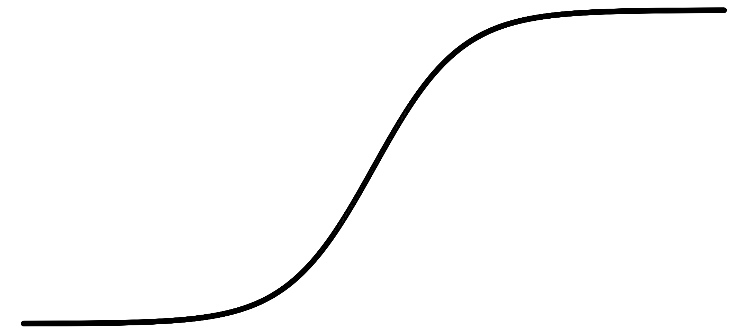
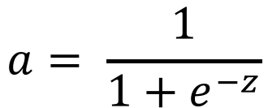
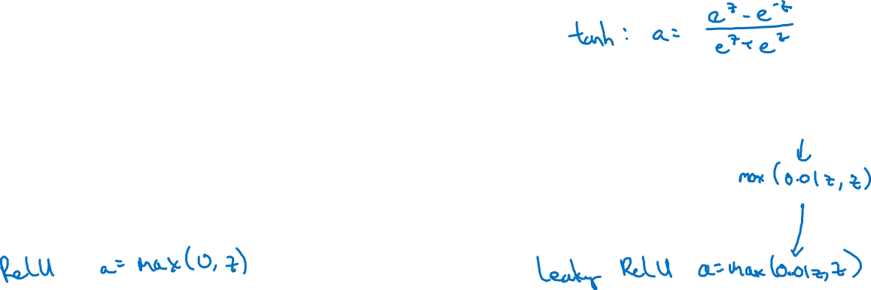
Pros and cons of activation functions
a
a
x
z
$$a= \frac{1}{1+e^{−z}}$$
sigmoid:
a
a
z
z

Slide 19
One hidden layer
Neural Network
Why do you
need non-linear
activation functions?

Slide 20



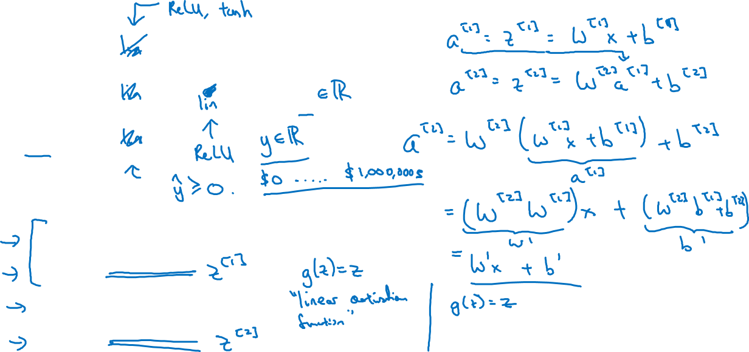



Activation function
$$x_{1}$$
$$x_{2}$$
$$\hat{y}$$
$$x_{3}$$
Given x:
$$z^{\left[1\right]}=W^{\left[1\right]}x+b^{\left[1\right]}$$
$$a^{\left[1\right]}=g^{[1]}(z^{\left[1\right]})$$
$$z^{\left[2\right]}=W^{\left[2\right]}a^{\left[1\right]}+b^{\left[2\right]}$$
$$a^{\left[2\right]}=g^{[2]}(z^{\left[2\right]})$$

Slide 21
One hidden layer
Neural Network
Derivatives of
activation functions

Slide 22
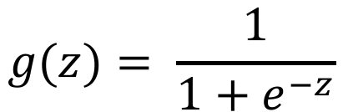
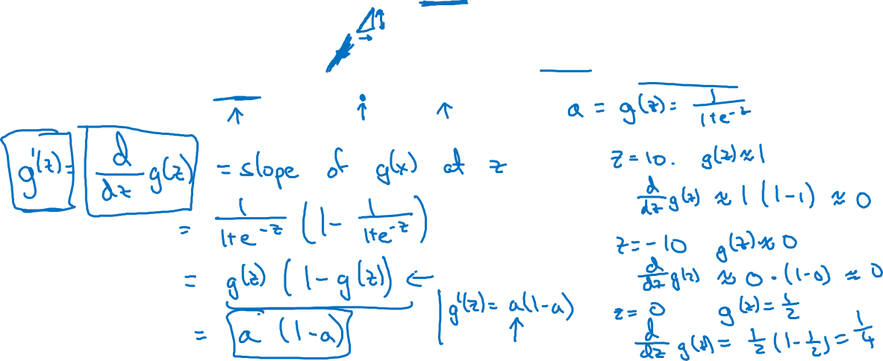
Sigmoid activation function
a
$$g(z)= \frac{1}{1+e^{−z}}$$
z

Slide 23

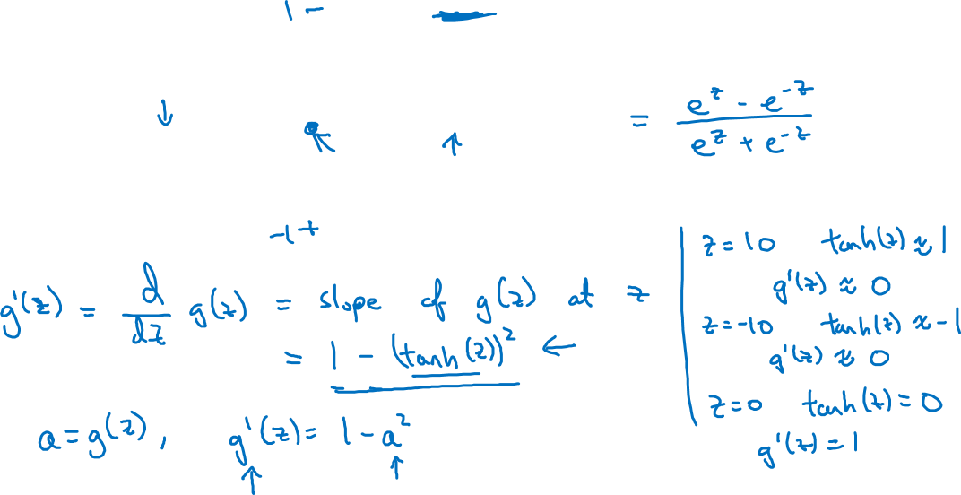
Tanh activation function
a
$$g(z)=tanh(z){ }$$
z

Slide 24
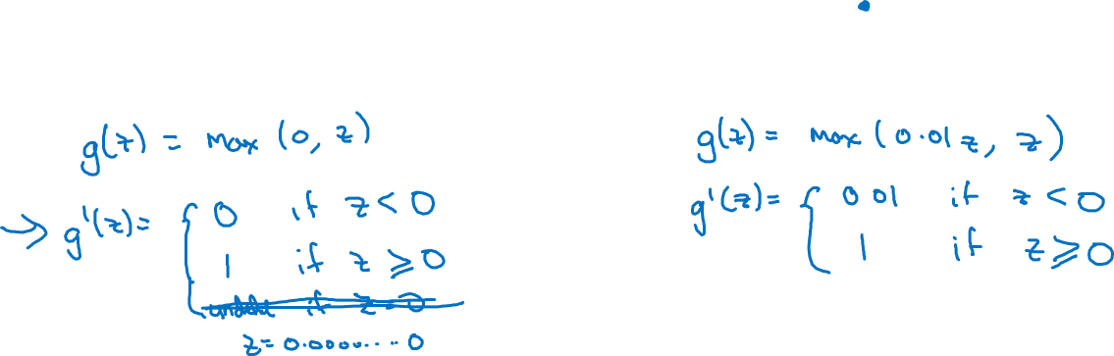
ReLU and Leaky ReLU
a
a
z
z
ReLU
Leaky ReLU

Slide 25
One hidden layer
Neural Network
Gradient descent for
neural networks

Slide 26
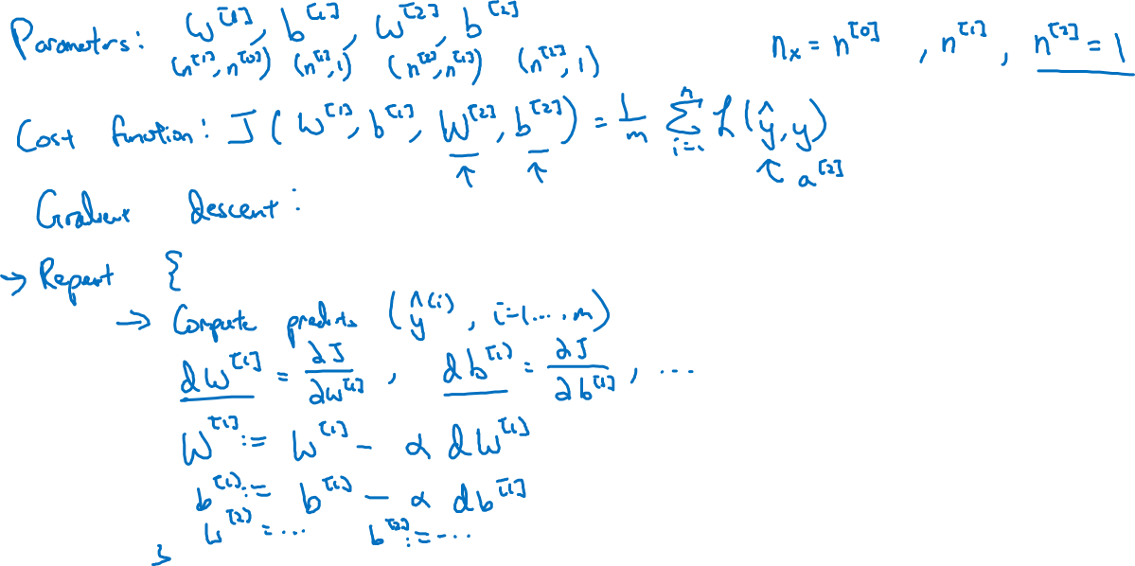
Gradient descent for neural networks

Slide 27
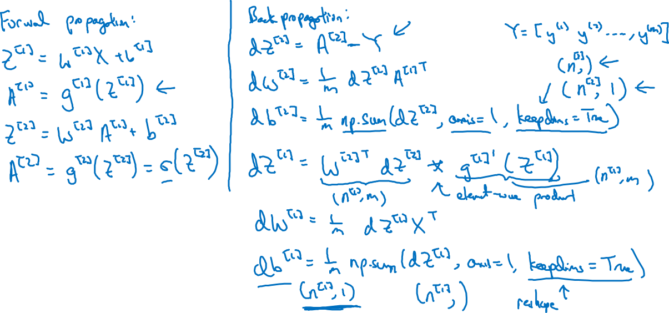
Formulas for computing derivatives

Slide 28
One hidden layer
Neural Network
Backpropagation
intuition (Optional)

Slide 29






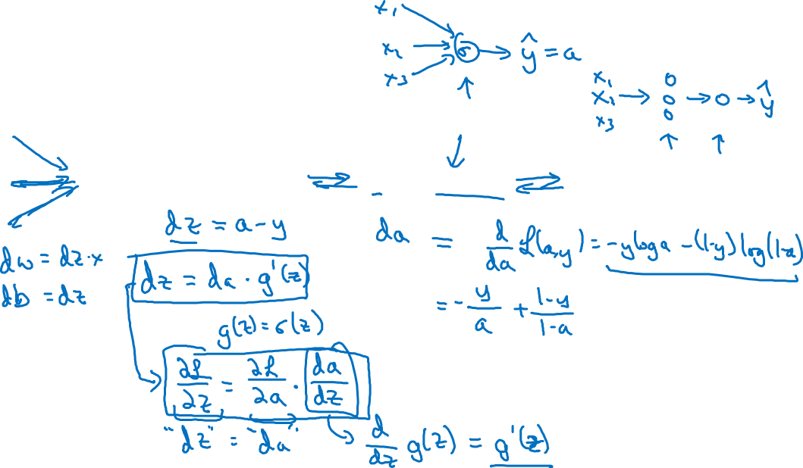
Computing gradients
Logistic regression
$$x$$
$$w$$
$$z=w^{T}x+b$$
$$a= σ(z)$$
$$ℒ(a,y)$$
$$b$$

Slide 30

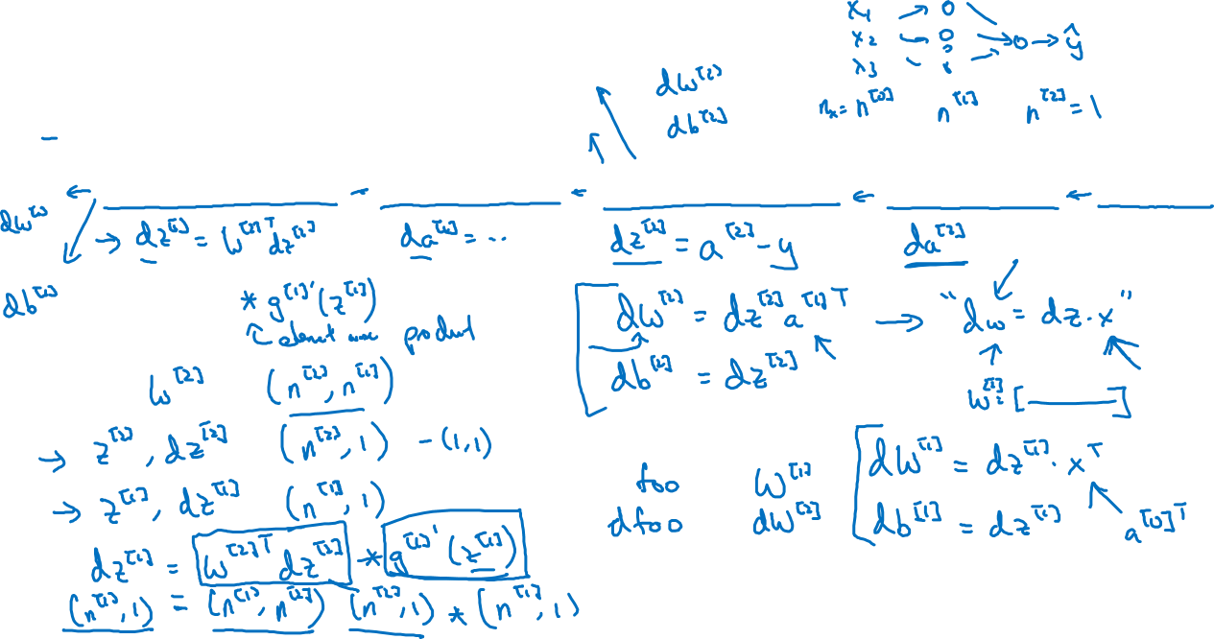



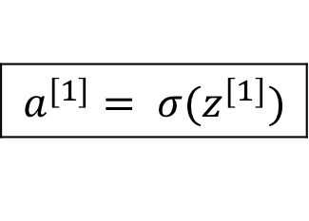





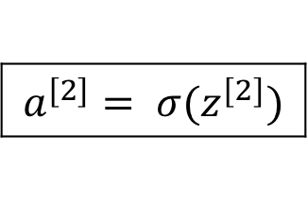
Neural network gradients
$$W^{[2]}$$
$$x$$
$$b^{[2]}$$
$$W^{[1]}$$
$$z^{[1]}=W^{[1]}x+b^{[1]}$$
$$a^{[1]}= σ(z^{[1]})$$
$$z^{[2]}=W^{[2]}x+b^{[2]}$$
$$a^{[2]}= σ(z^{[2]})$$
$$ℒ(a^{[2]},y)$$
$$b^{[1]}$$

Slide 31





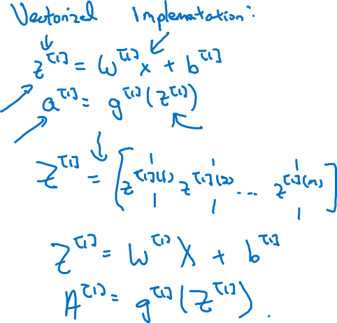
Summary of gradient descent
$$dz^{[2]}=a^{[2]}−y$$
$$dW^{[2]}=dz^{[2]}a^{{\left[1\right]}^{T}}$$
$$db^{[2]}=dz^{[2]}$$
$$dz^{[1]}=W^{\left[2\right]T}dz^{[2]}∗g^{[1]}′(z^{\left[1\right]})$$
$$dW^{[1]}=dz^{[1]}x^{T}$$
$$db^{[1]}=dz^{[1]}$$

Slide 32

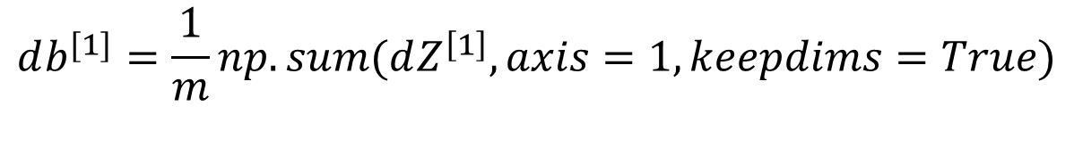
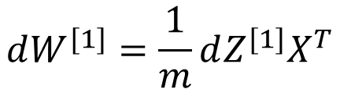
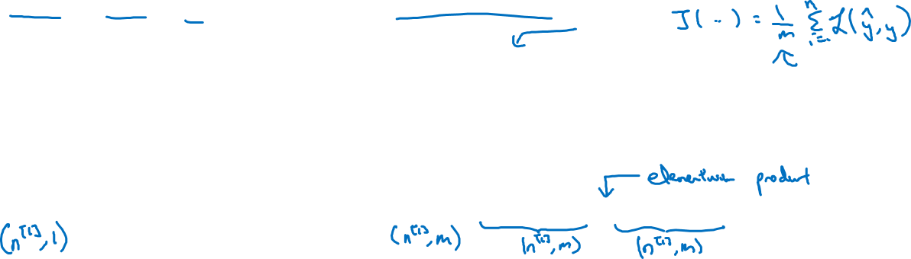
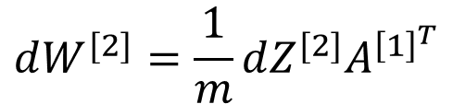
Summary of gradient descent
$$dz^{[2]}=a^{[2]}−y$$
$$dZ^{[2]}=A^{[2]}−Y$$
$$dW^{[2]}=dz^{[2]}a^{{\left[1\right]}^{T}}$$
$$dW^{[2]}=\frac{1}{m}dZ^{[2]}A^{{\left[1\right]}^{T}}$$
$$db^{[2]}=dz^{[2]}$$
$$db^{[2]}=\frac{1}{m}np.sum(dZ^{\left[2\right]},axis=1, keepdims=True)$$
$$dz^{[1]}=W^{\left[2\right]T}dz^{[2]}∗g^{[1]}′(z^{\left[1\right]})$$
$$dZ^{[1]}=W^{\left[2\right]T}dZ^{[2]}∗g^{[1]}′(Z^{\left[1\right]})$$
$$dW^{[1]}=dz^{[1]}x^{T}$$
$$dW^{[1]}=\frac{1}{m}dZ^{[1]}X^{T}$$
$$db^{[1]}=dz^{[1]}$$
$$db^{[1]}=\frac{1}{m}np.sum(dZ^{\left[1\right]},axis=1, keepdims=True)$$

Slide 33
One hidden layer
Neural Network
Random Initialization

Slide 34






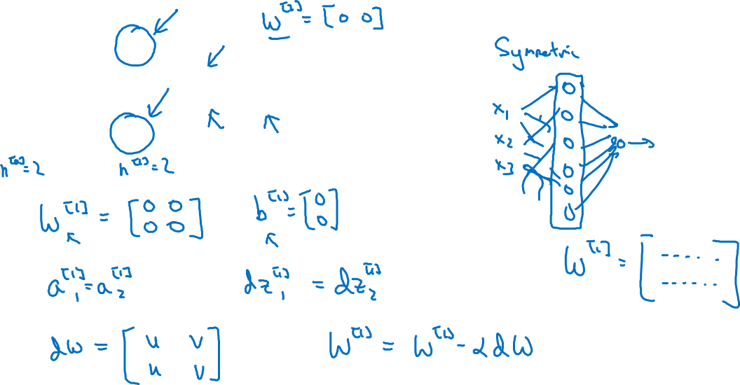
What happens if you initialize weights to zero?
$$x_{1}$$
$$a_{1}^{[1]}$$
$$a_{1}^{[2]}$$
$$\hat{y}$$
$$x_{2}$$
$$a_{2}^{[1]}$$

Slide 35
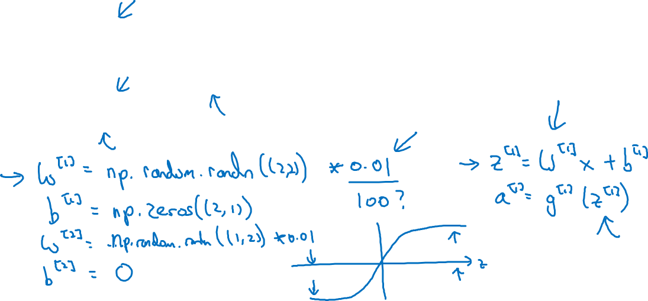
Random initialization
$$x_{1}$$
$$a_{1}^{[1]}$$
$$a_{1}^{[2]}$$
$$\hat{y}$$
$$x_{2}$$
$$a_{2}^{[1]}$$

